Slide 1

Investment Disclosure
User Guide

Slide 2
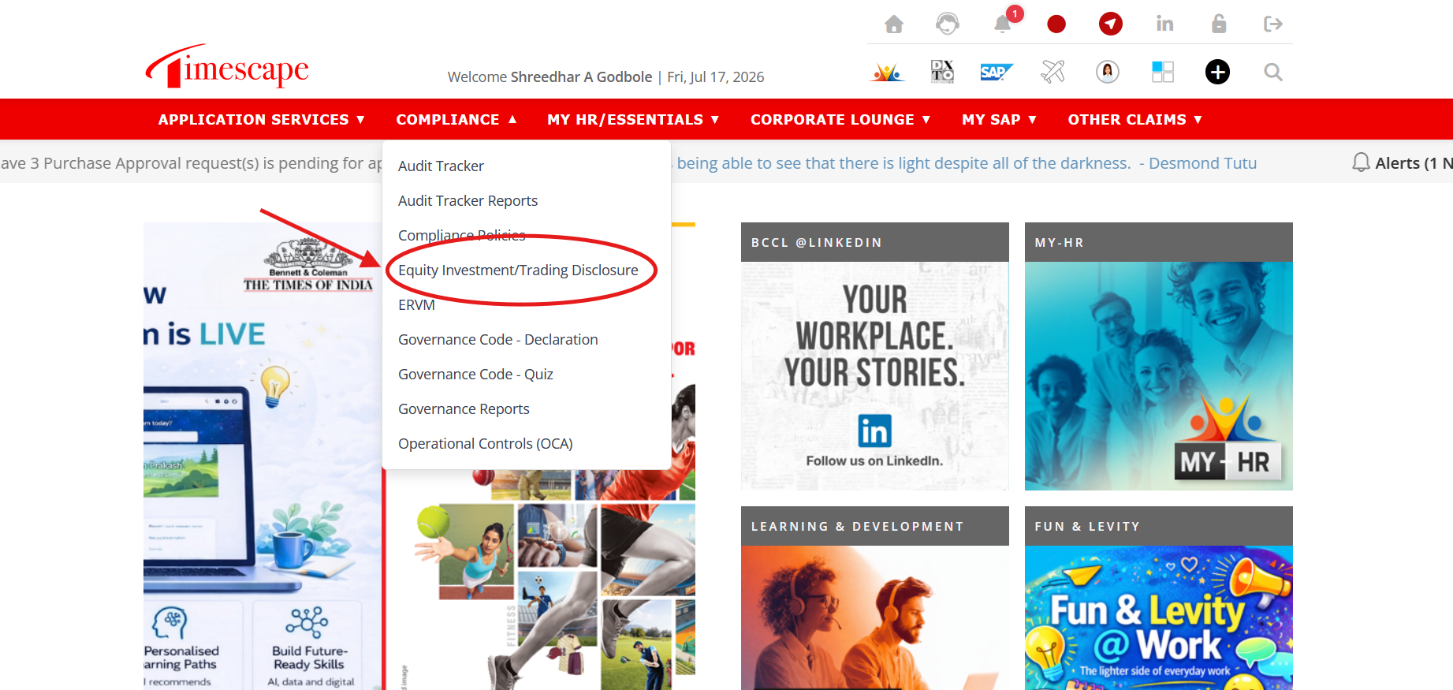
To Access Form : Timescape -> Compliance-> Equity Investment/Trading Disclosure

Slide 3
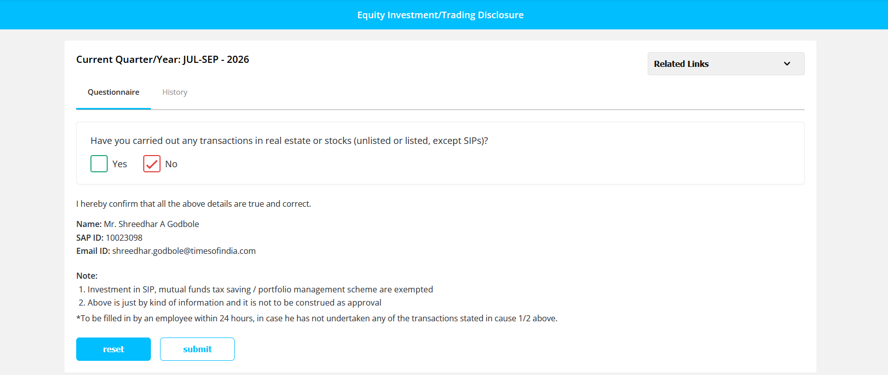
Select “No” In case no Relevant Transactions & Click “Submit” post that
No further action required after this step in case of “No”

Slide 4
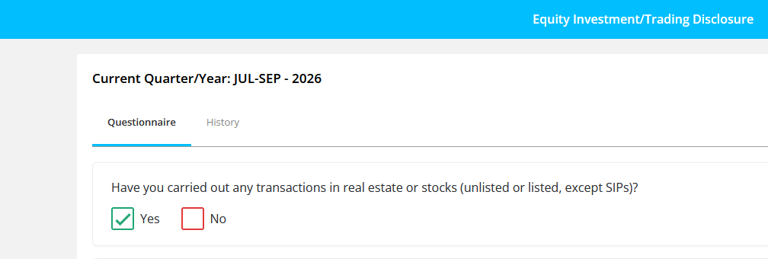
Select “Yes” In case of Relevant Transactions

Slide 5
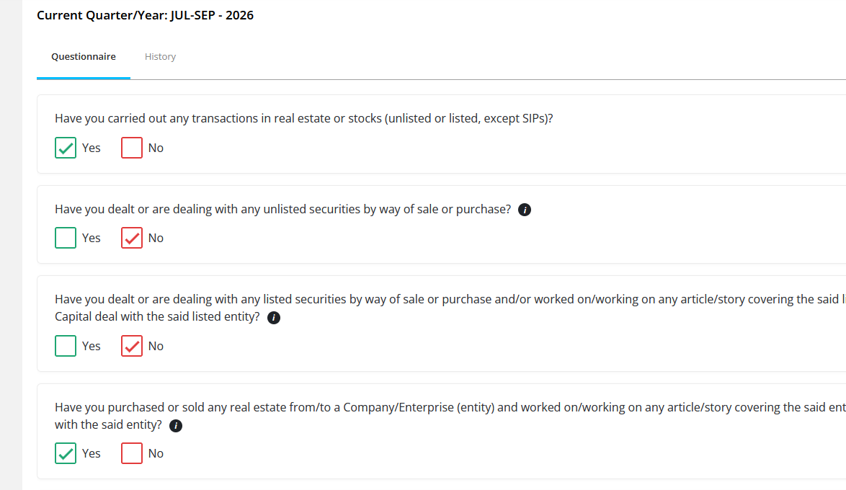
Select “Yes” for the Type of Transactions Undertaken
Select “Yes” where relevant

Slide 6
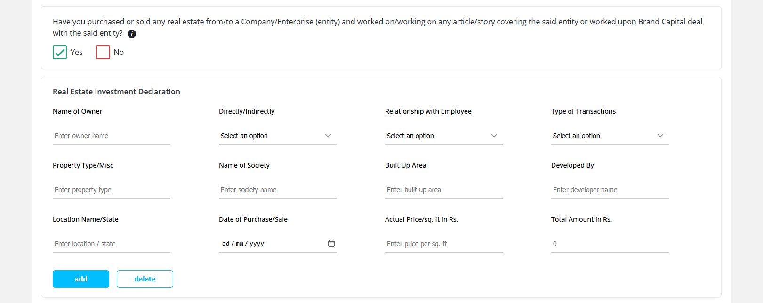
Based on Your Selection Relevant Sections will Open Up for you to fill in details of the transaction

Slide 7
Glossary of Terms used
Field | Remarks
Name of (Share) Owner | Enter the Name of the Person in whose name the transaction has been made
Directly/Indirectly | Select “Directly” if the transaction is done in your name OR “Indirectly” if done in dependants name.
Relationship with Employee | Select “Self” or “Dependent” as appropriate
Type of Transaction | Select “Purchase” or “Sale” as appropriate
No. of Shares | Number of shares purchased or sold in the transaction
Name of Unlisted Investee Company / Name of Listed Investee Company | Name of the company whose shares have been purchased/sold
Date of Transaction/Purchase/Sale | Date on which the transaction was effected
Rate per share | Price of each share (1 unit)
Total Amount | Total amount = Rater per share * No. of Shares. This gets auto calculated
Terms Specific to Property Transactions:
Property Type/Misc | Residential / Commercial
Name of Society | For Residential name of the project/society. For commercial name of the project
Built Up Area | The total area of a property (in sq ft), including the carpet area, walls, balconies, and other areas
Developed By | The name of the developer / builder
Location Name/State | Area, City, State name of the property
Actual Price/sq ft in Rs. | Per unit price

Slide 8
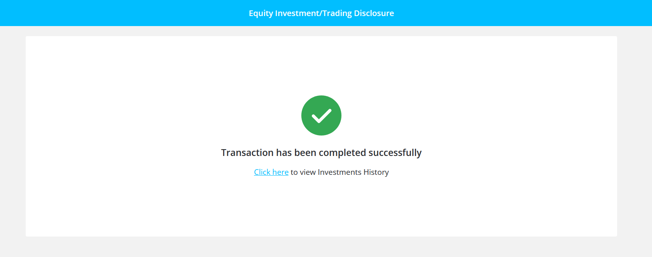
On Submission you will get a confirmation that your records have been submitted.
Click on the links to view history for all records

Slide 9
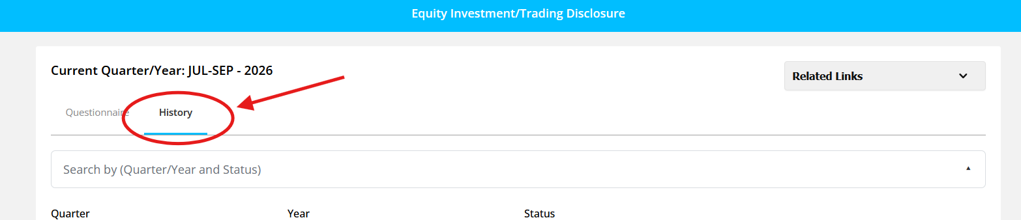
Post submission in case any data entered with errors, to delete them select history from header tab

Slide 10
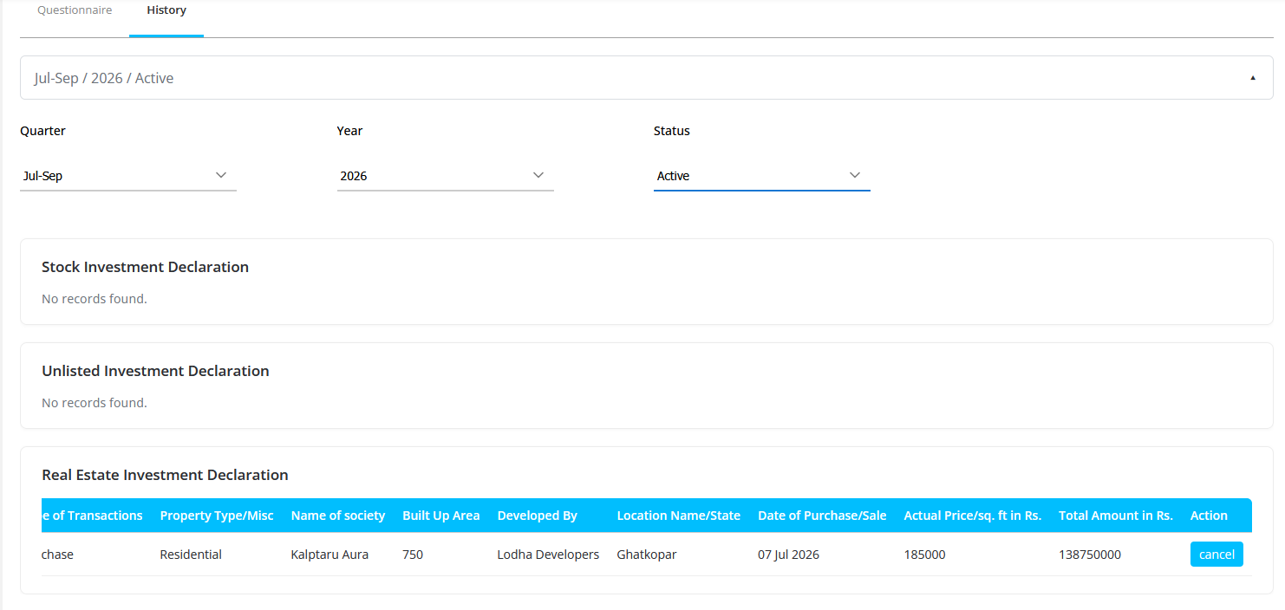
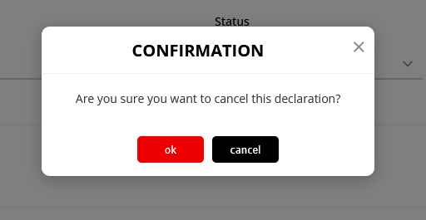
Click “Cancel” on erroneous record, Click “OK”
End of Document

